Slide 1

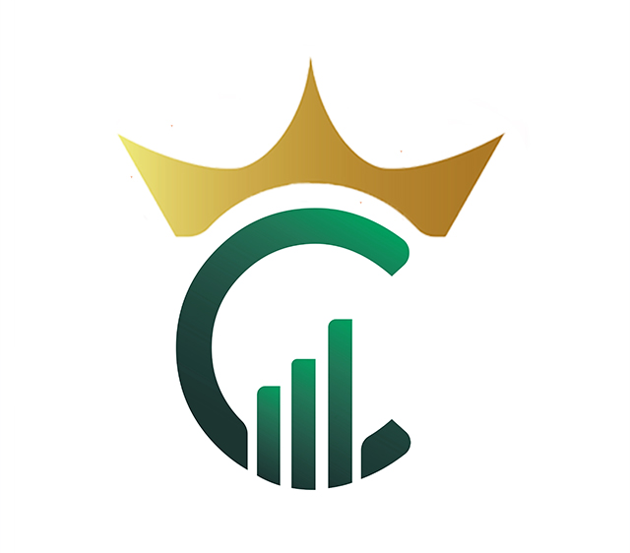
CRYPTOMARKINGS
The Crypto Market Kings

Slide 2

INTRODUCTION
The rise of cryptocurrency in recent years has taken the world by storm bypassing state regulators, providing privacy and unprecedented returns on investments as well as a new vision of financial markets..
Crypto traders and investors also take advantage of its volatility by engaging in various investments and trading approaches for locking in high investment returns.
With the introduction of CRYPTOMARKINGS Ecosystem, things are about to get better.

Slide 3


ABOUT
CRYPTOMARKINGS
CRYPTOMARKINGS is a Blockchain company focused on creating a blockchain ecosystem through which its subscribers can maximize the multiple financial potential in the crypto space. Cryptomarkings will constantly be updated to fit into emerging blockchain technologies for maximum profitability for its members.
a

Slide 4

CryptoMarkings Robots can trade contin. continuously even while you are sleep and while your computer is shut down.
It does all the work for you
EFFICIENT
REAL-TIME
REAL-TIME
STRATEGY
You can adjust the trading settings real-time to determine how
Cryptomarkings executes the trades for you
.
Advantages
Of
CryptoMarkings
It Does not store your trading assets, you keep your coins in your Binance or any other exchange account you use, Cryptomarkings is just permitted to execute trade through a protected API Binding. You are in charge of your fund.
SAFE

Slide 5

CryptoMarkings simplifies the trading process
And help you to achieve consistent gain
SIMPLE
REAL-TIME
PROFITABLE
.
The trading strategies are highly profitable.
Cryptomarkings also comes with very rewarding compensation plans
Advantages
Of
CryptoMarkings
It contains verse functionalities such as trading Bots, manual & Copy trading functions, P2P Marketplace, Crypto Gem signals, Crypto Academy and more to come.
VERSATILE

Slide 6
1. Artificial Intelligence
Trading Robot designed to execute automated trading processes in real-time
.
5. Crypto GEMS Signals provisions
Cryptomarkings offers private sale, ICO, IDO, IEO and early listing signals on tokens/coins with great potential of generating massive return for those who Hodl.
FEATURES
2. Manual Trading
Manual trading tool for professional traders to execute their trades manually, to earn commissions when others copy their trades
GO
6. Academy
Crypto and blockchain educational resources
3. Copy Trading
To enable amateur and busy traders copy the trade of other professional traders and maximize profits.
.
TRADE
7. CMK Token Cryptomarkings will launch its own native token known as CMK in the future, this will unlock more features such as Staking, DEX, Farming, Crypto project Incubation and more
EARN
4. P2P Crypto marketplace
For traders to buy and sell crypto with fiat from other traders near them

Slide 7
HOW TO GET STARTED
Download APP
Register
Subscribe
API Binding
Start Trading
Download CryptoMarkings app from play store or Appstore
Register for free, if you are referred by someone, type his/her username on referral field
Chose a subscription package of your choice
Bind your Exchange API to Cryptomarkings
Set your trade settings or chose strategy manager to copy his trade and start trading

Slide 8


WHAT IS
ARTIFICIAL INTELLIGENCE
(AI) TRADING
AI trading refers to the buying and selling of assets without the need for human interaction. Artificial intelligence trading uses a pre-defined algorithm to place trades automatically without the need for human interaction.

Slide 9

KNIGHT ROBOT
SPOT TRADING
The Cryptomarkings Knight Robot uses indicators to analyze the market charts. These indicators are a default component of the robot which can automatically execute trades for you without the need for prior settings. Traders can as well input their desired settings on the Robot.

Slide 10

CENTURION ROBOT
SPOT TRADING
The Cryptomarkings Centurion Robot trades on the SPOT market, it is designed to take into account market Fundamentals and various technical analysis techniques. The core of this robot is to enable a reasonable profit margin even in a bearish market

Slide 11

EMPEROR ROBOT
FUTURES TRADING (Coming soon)
The Cryptomarkings Emperor Robot trades on the FUTURES market, it is designed to take into account market Fundamentals and various technical analysis techniques. The core of this robot is to enable a reasonable profit margin even in a bearish market

Slide 12

PRE-Launch Pricing Table
Markings 2
Markings 0
Markings 1
$50
$150
$2
Per Year
Per Year
500 SV
50 SV
150 SV
2 SV
Maximum Trade: $20,000
Maximum Trade: $1000
Maximum Trade: $5,000
Direct Referral reward: 25%
Weekly Binary Cap: $200
Direct Referral reward: 10%
Direct Referral reward: 20%
Weekly Binary Cap: $30
Weekly Binary Cap: $100
Products: Education, Robots, P2P, Manual, Copy trading & GEMS signals
Products: Education, Manual trade & P2P trading
Products: Education, Robots, P2P, Manual & Copy trading
BUY NOW
BUY NOW
BUY NOW
BUY NOW
NOTE: $2 Signup Bonus will be rewarded to you for “Markings 0” automatic subscription. You can fund your wallet to upgrade your subscription

Slide 13



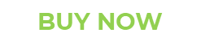
PRE-Launch Pricing Table
Markings 3
Markings 4
Markings 5
Markings 2
Markings 1
$500
$1500
$5000
Markings 3
$500
Per Year
Per Year
Per Year
Per Year
500 SV
1500 SV
5000 SV
500 SV
Maximum Trade: $5000
Maximum Trade: $100,000
Maximum Trade: Infinity
Direct Referral reward: 45%
Direct Referral reward: 55%
Direct Referral reward: 35%
Maximum Trade: $50,000
Direct Referral reward: 35%
Weekly Binary Cap: $4000
Weekly Binary Cap: $800
Weekly Binary Cap: $1500
Weekly Binary Cap: $800
Products: Education, Robots, P2P, Manual, Copy trading & GEMS signals
Products: Education, Robots, P2P, Manual & Copy trading, GEMS signals
Products: Academy, Robots, P2P, Manual & Copy trading, GEMS signals
Products: Education, Robots, P2P, Manual & Copy trading, GEMS signals
BUY NOW
BUY NOW
Benefits of joining Cryptomarkings’ Pre-Launch: Extra 5% direct referral reward, 2X weekly binary Cap and 2X Binary reward, till the end of Pre-Launch.

Slide 14
Main Launch Pricing Table
Markings 0
Markings 2
Markings 1
$2
$50
$150
Per Year
Per Year
Per Year
2 SV
50 SV
150 SV
Maximum Trade: $1000
Maximum Trade: $5000
Maximum Trade: $20,000
Direct Referral reward: 10%
Direct Referral reward: 15%
Direct Referral reward: 20%
Weekly Binary Cap: $30
Weekly Binary Cap: $50
Weekly Binary Cap: $100
Products: Education, Robots, P2P, Manual & Copy trading
Products: Education, P2P, Manual trading
Products: Education, Robots, Manual trades & P2P trading
BUY NOW
BUY NOW
BUY NOW
NOTE: $2 Signup Bonus will be rewarded to you for “Markings 0” automatic subscription. You can fund your wallet to upgrade your subscription

Slide 15
Main Launch Pricing Table
Markings 5
Markings 4
Markings 3
$5000
$1500
$500
Per Year
Per Year
Per Year
1500 SV
5000 SV
500 SV
Maximum Trade: Infinity
Maximum Trade: $50,000
Maximum Trade: $100,000
Direct Referral reward: 40%
Direct Referral reward: 50%
Direct Referral reward: 30%
Weekly Binary Cap: $800
Weekly Binary Cap: $2000
Weekly Binary Cap: $400
Products: Education, Robots, GEMS Signals, P2P, Manual & Copy trading
Products: Education, Robots, P2P, Manual, Copy trading & GEMS signals
Products: Education, Robots, P2P, GEMS signals, Manual & Copy trading
BUY NOW
BUY NOW
BUY NOW
SV = Subscription Value

Slide 16

To Start Trading
• Subscribe to a package (Minimum $50)
Deposit a minimum of $20 in your Fuel wallet for trading fees charges.
• Fund your Binance trading account with at least, $100 or more to start trading.
Total minimum to start trading is $190

Slide 17
NETWORK COMPENSATION PLANS
Binary Reward
Leadership Reward

Slide 18
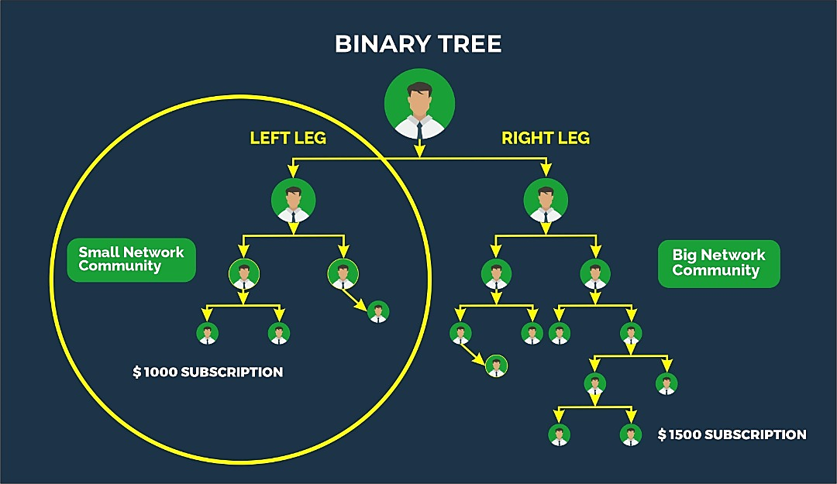
BINARY
REWARD
10% Weekly binary commission
till infinity (Main launch)
NOTE: 20% Weekly binary commission
during Pre-Launch
Here, new members sponsored by distributors are added either on the left or right leg. All the new members referred after forming a binary tree are spilled to the downlines.
NOTE: YOU WILL BE CREDITED 10% OF THE SUBSCRIPTION VALUE (SV) OF YOUR SMALL NETWORK COMMUNITY WEEKLY.
1 SV = $1
BINARY REWARD = Small Community’s SV/weekly x 10%. If total customer equals 1,000 customers on small zone . Binary reward (BR)= Subscription Value weekly x10%.
E.g. If total Subscription Value (SV) is 15,200 then BR =15,200 x 10% = 1520 weekly. So BR is $1,520.

Slide 19

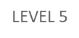
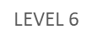
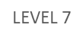
LEADERSHIP REWARD (Unilevel)
Here, You earn a percentage of your downline’s fuel fees. You earn from your level 1 to 7 downlines depending on your Leadership Rank.
20%
CONSTR.
8%
LEVEL 1
LEVEL 2
5%
LEVEL 3
5%
3%
LEVEL 4
2%
2%

Slide 20
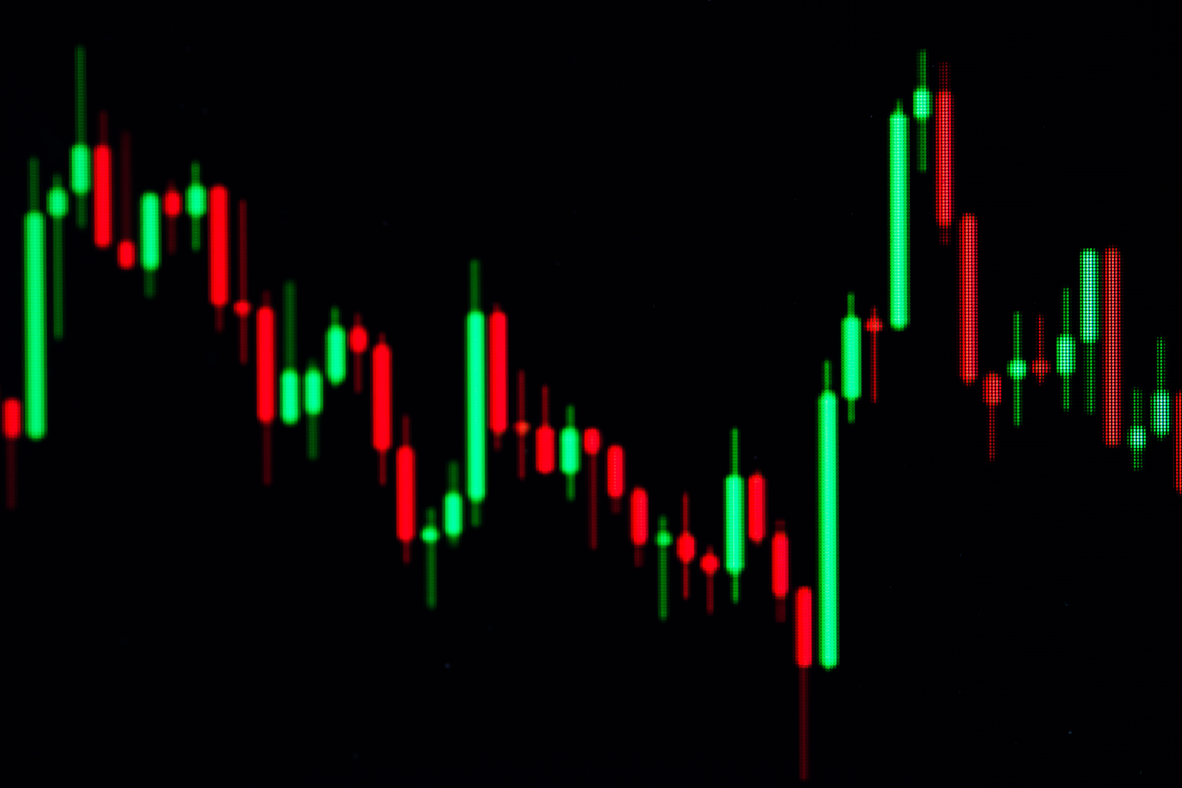
LEADERSHIP REWARD RANKS

Slide 21

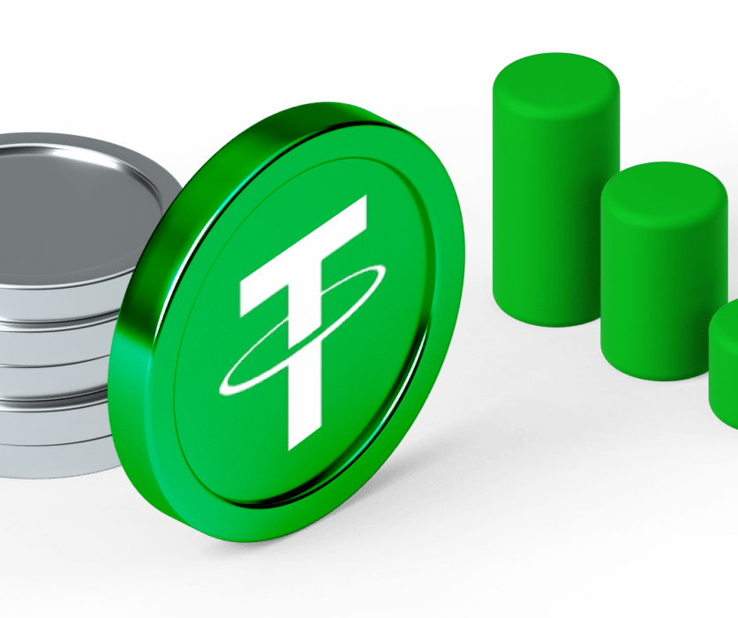
1. BARON
•Refer two persons irrespective of their rank and subscription package
EARNINGS: Level 1

Slide 22

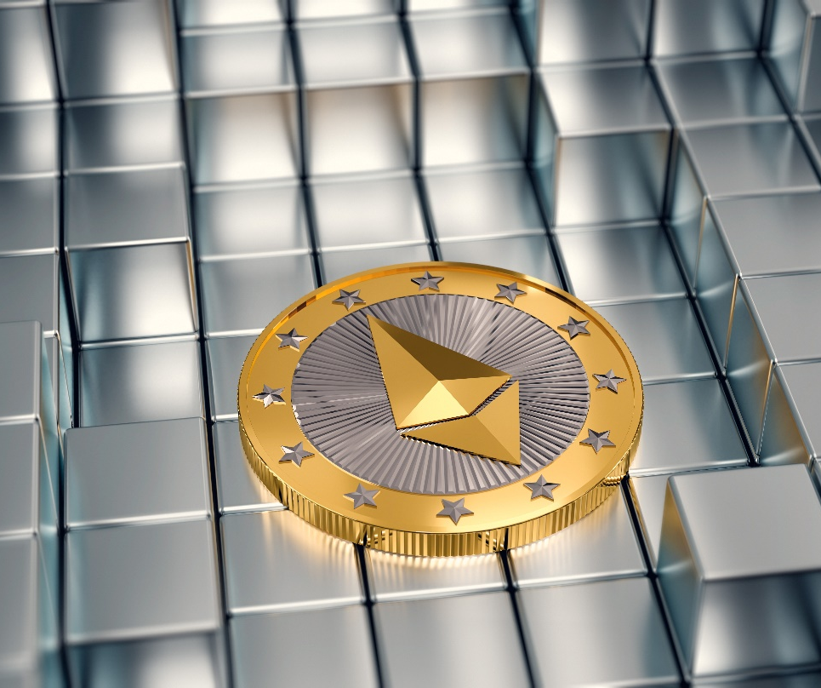
2. VISCOUNT
• Personally refer 4 persons
• Have a total of 20 persons in your entire team.
EARNINGS: Level 1 - 2

Slide 23

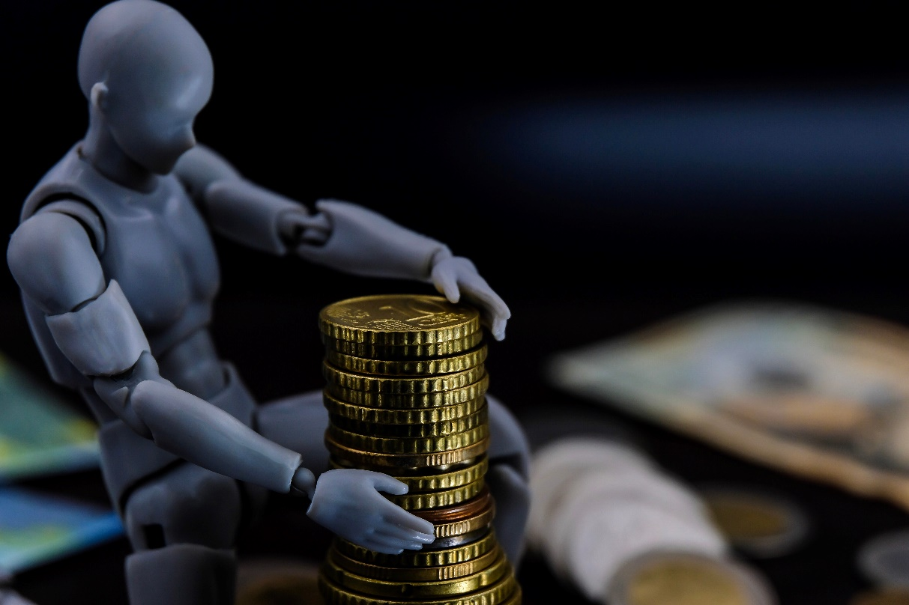
3. EARL
• Personally refer 8 persons
• have a total of 100 persons in your entire team.
• Have at least 3 Viscounts you referred directly
EARNINGS: Level 1 - 4

Slide 24

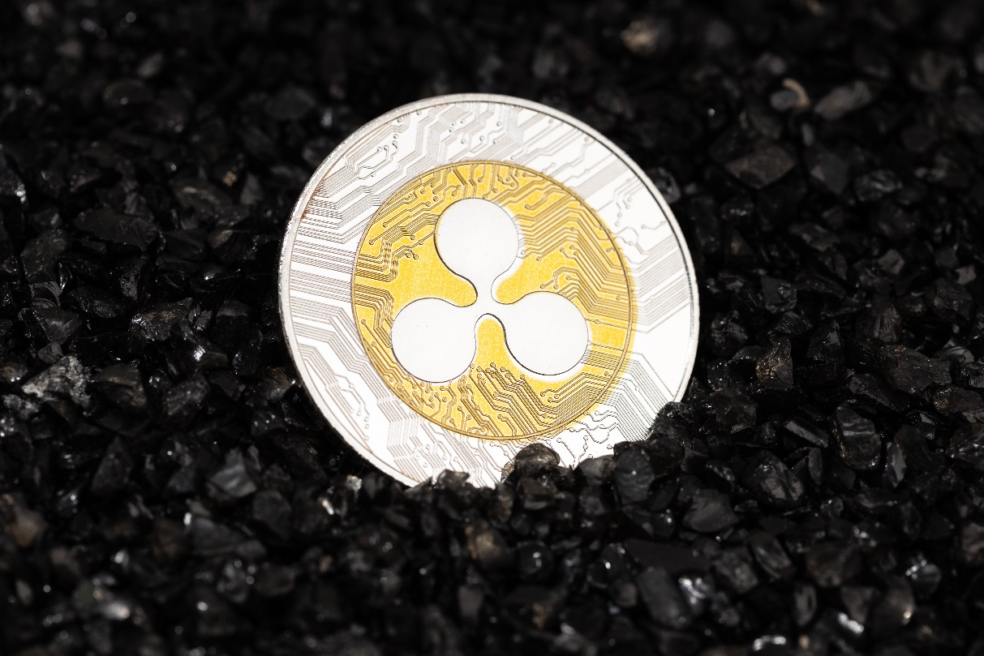
4. DUKE
• Personally refer 12 persons
• Have a total of 200 persons in your entire team.
• Have at least 3 Earls you referred directly.
EARNINGS: Level 1 -5

Slide 25

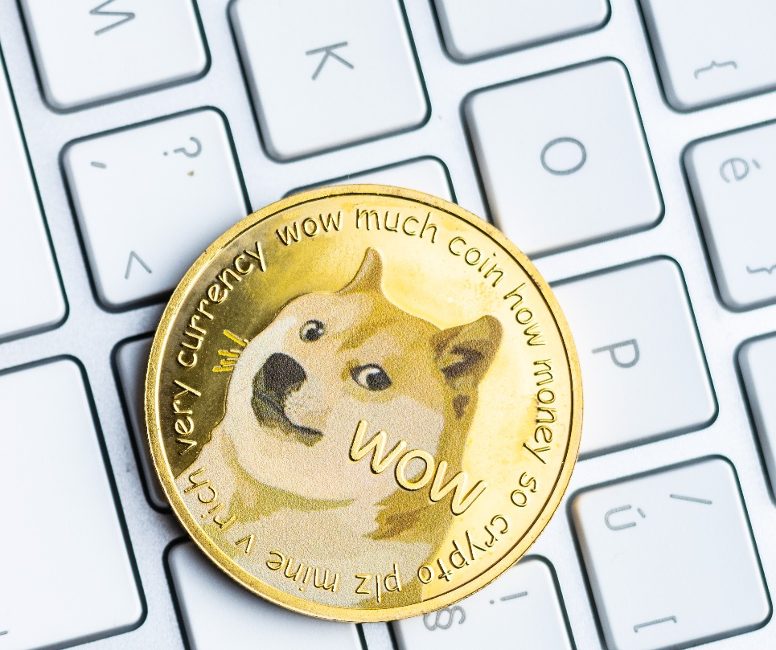
5. PRINCE
• Personally refer 15 persons
• Have a total of 500 persons in your entire team.
• Have at least 3 DUKES you referred directly
EARNINGS: Level 1-6

Slide 26

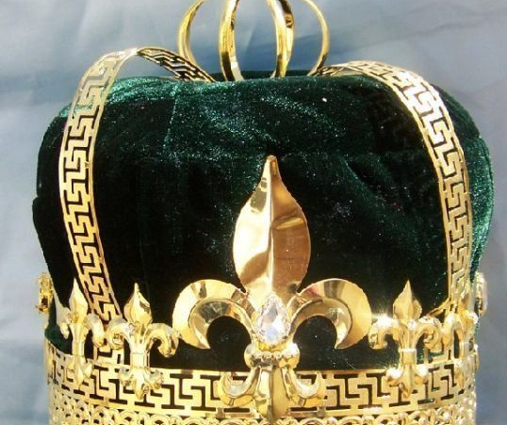
6. KING
• Personally refer 20 persons
• Have a total of 2000 persons in your entire team.
• Have at least 3 PRINCES you referred directly
EARNINGS: Level 1-7 &
5% Global Pool Reward

Slide 27
CRYPTOMARKINGS
Ecosystem Roadmap
Q2, 2023
Q4, 2022
Q1, 2023
Cryptomarkings mobile app launch with Robots, Crypto Gems signals, Manual & Copy trade features
Addition of P2P trading marketplace and integration of other Exchanges to the mobile app
Web version of Cryptomarkings platform. CMK Token Launch
Q3, 2023
Q4, 2023
Beta version of Cryptomarkings Decentralized exchange (Kingswap) Crypto project incubation
Staking and farming platform launch. NFT marketplace (Beta).

Slide 28



CryptoMarkings LIMITED
The Crypto Market Kings
Company Registration No: 13798279
27 Worlingham Road, London
United Kingdom, SE22 9HD.
support@cryptomarkings.net
https://cryptomarkings.net
Your Ideal Multifaceted crypto trading tools to maximize trading profits while minimizing risk and loss

Slide 29

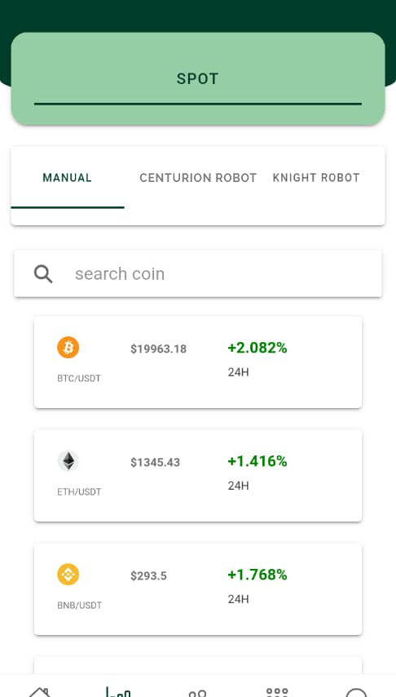
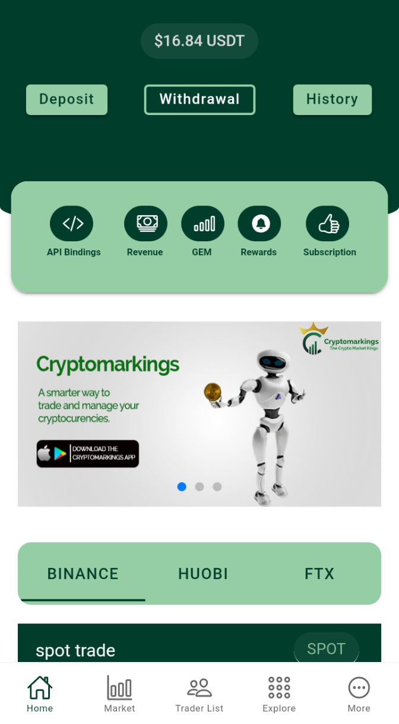
CRYPTOMARKINGS
Mobile APP
download now

